Slide 1
Triacylglycerol and Phospholipids biosynthesis

Slide 2
Objectives
Basic steps in synthesis of triacylglycerol (TAG) and phospholipids (PL)
Regulation of TAG and PL synthesis
Basic steps in degradation of TAG and PL
Diseases due to abnormalities in metabolism of TAG and PL

Slide 3
Ttriacylglycerol synthesis
Synthesized in adipose tissue and liver and lactating mammary gland from excess carbohydrates.
Precursors:
Biosynthesis of TAG needs two (2) precursors
  Glycerol-3-phosphate
  Fatty acyl-CoA

Slide 4
Synthesis of glycerol phosphate
Glycerol phosphate is the initial acceptor of fatty acids during TAG synthesis
There are two pathways for glycerol phosphate production
    From glucose in both liver (1^{ry} site) & adipose tissue (intermediates of glycolysis)
    From glycerol (only in liver; presence of glycerol kinase)

Slide 5
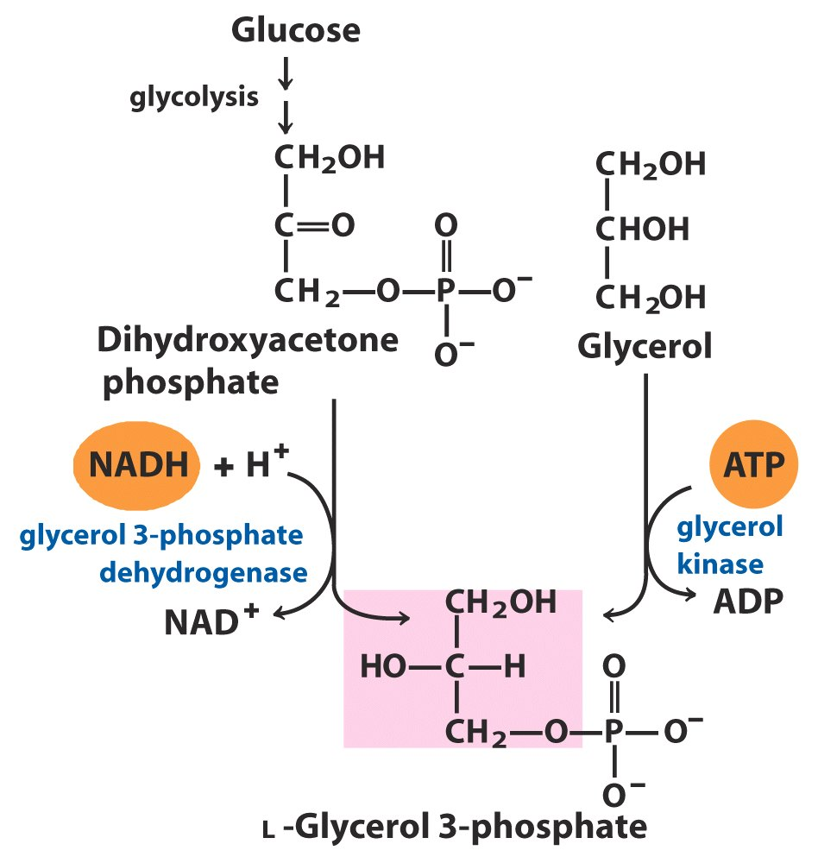
Liver
The majority of glycerol 3-P derives from DHAP

Slide 6
Activation of fatty acids
FA must be activated (attached to CoA)
Catalyzed by fatty acyl CoA synthase (thiokinases)
O
O
fatty acyl CoA synthase
CoA
R
OH
R
S
Fatty acid
Fatty acyl CoA

Slide 7
Ttriacylglycerol synthesis
Involves four steps
Addition of 1st fatty acid (from fatty acyl CoA)
Addition of 2nd fatty acid (from fatty acyl CoA)
  generates a phosphatidic acid
Removal of phosphate group
  generates diacylglycerol (DAG)
Addition of 3rd fatty acid (from fatty acyl CoA)

Slide 8
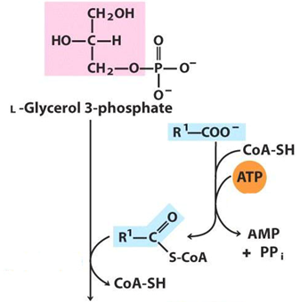
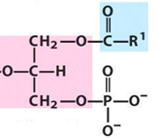
fatty acyl CoA synthase
Glycerol 3 phosphate
acyltransferase

Slide 9
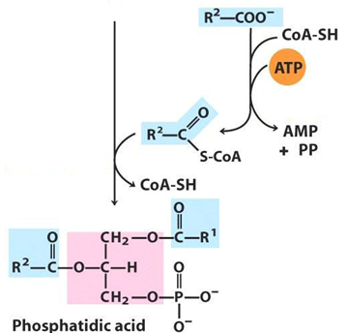
1-acyl - glycerol 3 phosphate
acyltransferase
fatty acyl CoA synthase

Slide 10
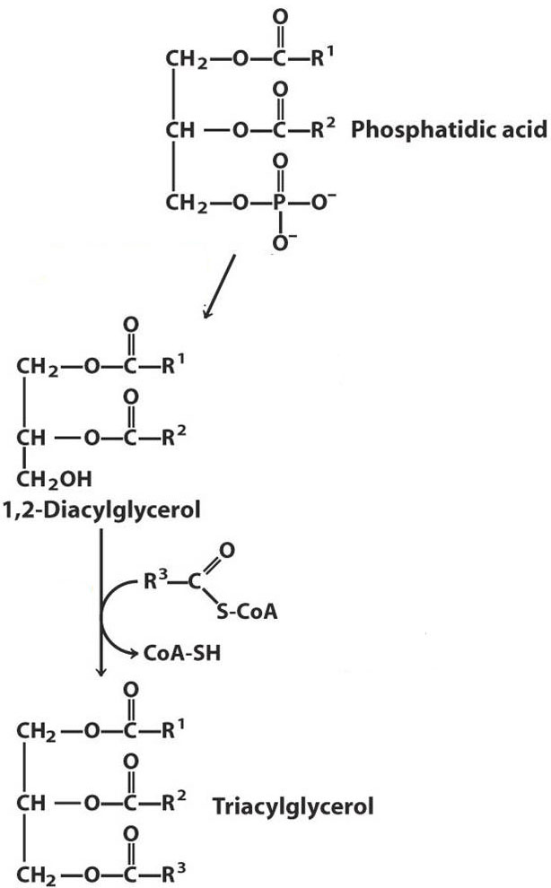
Phosphatidic acid phosphohydrolase
Diacylglycerol
Acyl-transferase

Slide 11
Fate of TAG
In adipose tissue:
TAG is stored in the cytosol
Ready for mobilization when body require it for fuel
In liver:
Most is exported, packed in lipoprotein VLDL particles to peripheral tissues

Slide 12
Phospholipids
Two Classes
Glycerophospholipids
    Posphatidic acid + alcohol
  Spingophospholipids
    Ceramide (Spingosine + Fatty acid) + alcohol

Slide 13
Glycerophospholipids synthesis
All cells (except mature RBC) can synthesize PL
PL are synthesized in Smooth endoplasmic reticulum (SER)
Phosphatidic acid is the precursor of glycerophospholipids
Primary step is activation either of diacylglycerol or the alcohol by linking with CDP group (cytidine diphosphate)
(CDP bound form is considered an “activated intermediate”)

Slide 14
Ethanolamine or Choline
Phosphatidic acid
thiokinase
Phospho ethanolamine or
Phospho choline
CDP Diacylglycerol
CDP –Ethanolamine or
CDP -Choline

Slide 15
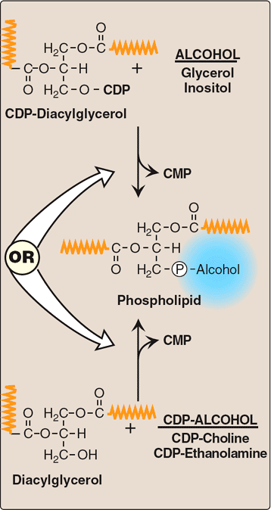
Involves either the donation of phosphatidic acid from CDP-diacylglycerol to an alcohol
CDP-diacylglycerol + Alcohol
Or
The donation of the phosphomonoester of the alcohol from CDP-alcohol to 1,2-diacylglycerol
Diacylglycerol + CDP-Alcohol

Slide 16
Variety of phospholipids
Ethanolamine (CDP-Ethanolamine) | + DAG → | Phosphatidylethanolamine (PE)(cephalin)
Choline (CDP-Choline) | + DAG → | phosphatidylcholine (lecithin)
Inositol | + CDP-DAG → | phosphatidylinositol
Glycerol | + CDP-DAG → | phosphatidylglycerol
Serine | + PE → | phosphatidylserine

Slide 17
Degradation of Phosphoglycerides
Degradation is performed by phospholipases found in all tissues and pancreatic juice
Phospholipases hydrolyze the ester bonds of phosphoglycerides
Several types of phospholipases are present
Each enzyme cleaves the phosphoglyceride at a specific site

Slide 18
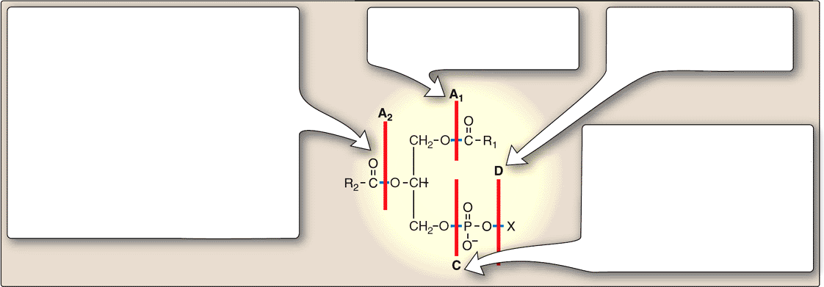
Phospholipases
Phospholipase A₂
Present in many tissues & pancreatic juice and snake & bee venoms
Acting on phosphotidylinositol, releases arachidonic acid
Inhibited by glucocorticoids (eg: cortisol)
Phospholipase A₁
Present in many tissues
Phospholipase D
Found in plants
Phospholipase C
Found in liver lysosomes & α-toxin of Clostridia & other bacilli
Plays a role in producing 2nd messengers

Slide 19
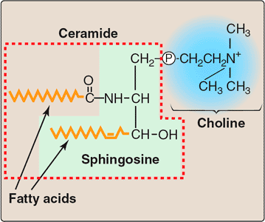
Degradation of sphingomyelin
Degraded by sphingomyelinase, a lysosomal enzyme
Hydrolytically removes phosphorylcholine, leaving a ceramide
The ceramide is in turn cleaved by ceramidase into sphingosine & a fatty acid
sphingomyelinase
ceramidase

Slide 20
PL & SL in diseases
Respiratory distress syndrome
  Insufficient production &/or secretion of surfactant (DPPC-dipalmitoylphosphatidylcholine)
Spingolipidosis
  Accumulation of a spingolipid in the lysosomes
  (due to the deficiency of hydrolase)
    Eg: Niemann-Pick disease – sphingomyelinase deficiency
    Gaucher disease
    Tay-Sachs disease

Slide 21
Diseases in PL and SL
Medical Condition Defective Enzyme Major Accumulating Metabolite
Generalized Gangliosidosis Beta-Galactosidase GM1
Tay-Sachs Disease Hexosaminidase A GM2
Gaucher’s Disease Glucocerebrosidase Glucosylcerebroside
Niemann-Pick Disease Sphingomyelinase Sphingomyelin
Sandhoff’s Disease Hexosaminidase A&B A Globoside*
Fabry’s Disease Alpha-Galactosidase A A Globoside*
*The globosides that are substrates for the defective enzymes in these diseases do not have specific names, but are referred to by the broad term globoside.

Slide 22


